Slide 1
Information System Strategic Plan ISSP Presentation
Volunteer Advisor

Slide 2
Agenda
Introduction
Vision & Mission IT
Identify where you are
Environmental Analysis
Resource Analysis
Needs Analysis
Identify Strategic Choices
Implementation
Evaluation

Slide 3
Step 1 Introduction to Strategic Planning
If you fail to plan, plan to fail

Slide 4
Where is IT?

Slide 5
Information System Strategic Plan
An Information System Strategic Plan (ISSP) is a document that details the comprehensive technology-enabled business management processes an organization uses to guide operations.

Slide 6
It serves as a guide to IT-related decision making, with IT tasks prioritized and implemented using the plan as a framework.

Slide 7
The ISSP includes:
Strategic Plan Where are we? Where are we going? Why? How will we get there?
Project Plan What are we trying to achieve? How will we make it happen?
Operational Plan What do we need to do to make it all happen and know we are on track?
Service Plan Who are the clients? What will be their benefits? How?
Financial Plan Where is the money coming from? Where is it going to? Is it enough?
Evaluation Plan How do we know we are doing a good job? How do we improve what we are doing?

Slide 8
Step 2 Vision and mission
They explain why you exist as a business, both to members of the organization and to people outside it.

Slide 9
Vision statements define your organization's purpose and they focus on its goals and aspirations.
Focus on TOMORROW
Mission statements define the organization's purpose and primary objectives.
Focus on NOW

Slide 10
How can the ISSP plan help me achieve my mission?

Slide 11
Step 3 Identify where you are

Slide 12
Objectives and Strategies
A first step for your plan will be to determine where you are right now but also where you want to go.

Slide 13
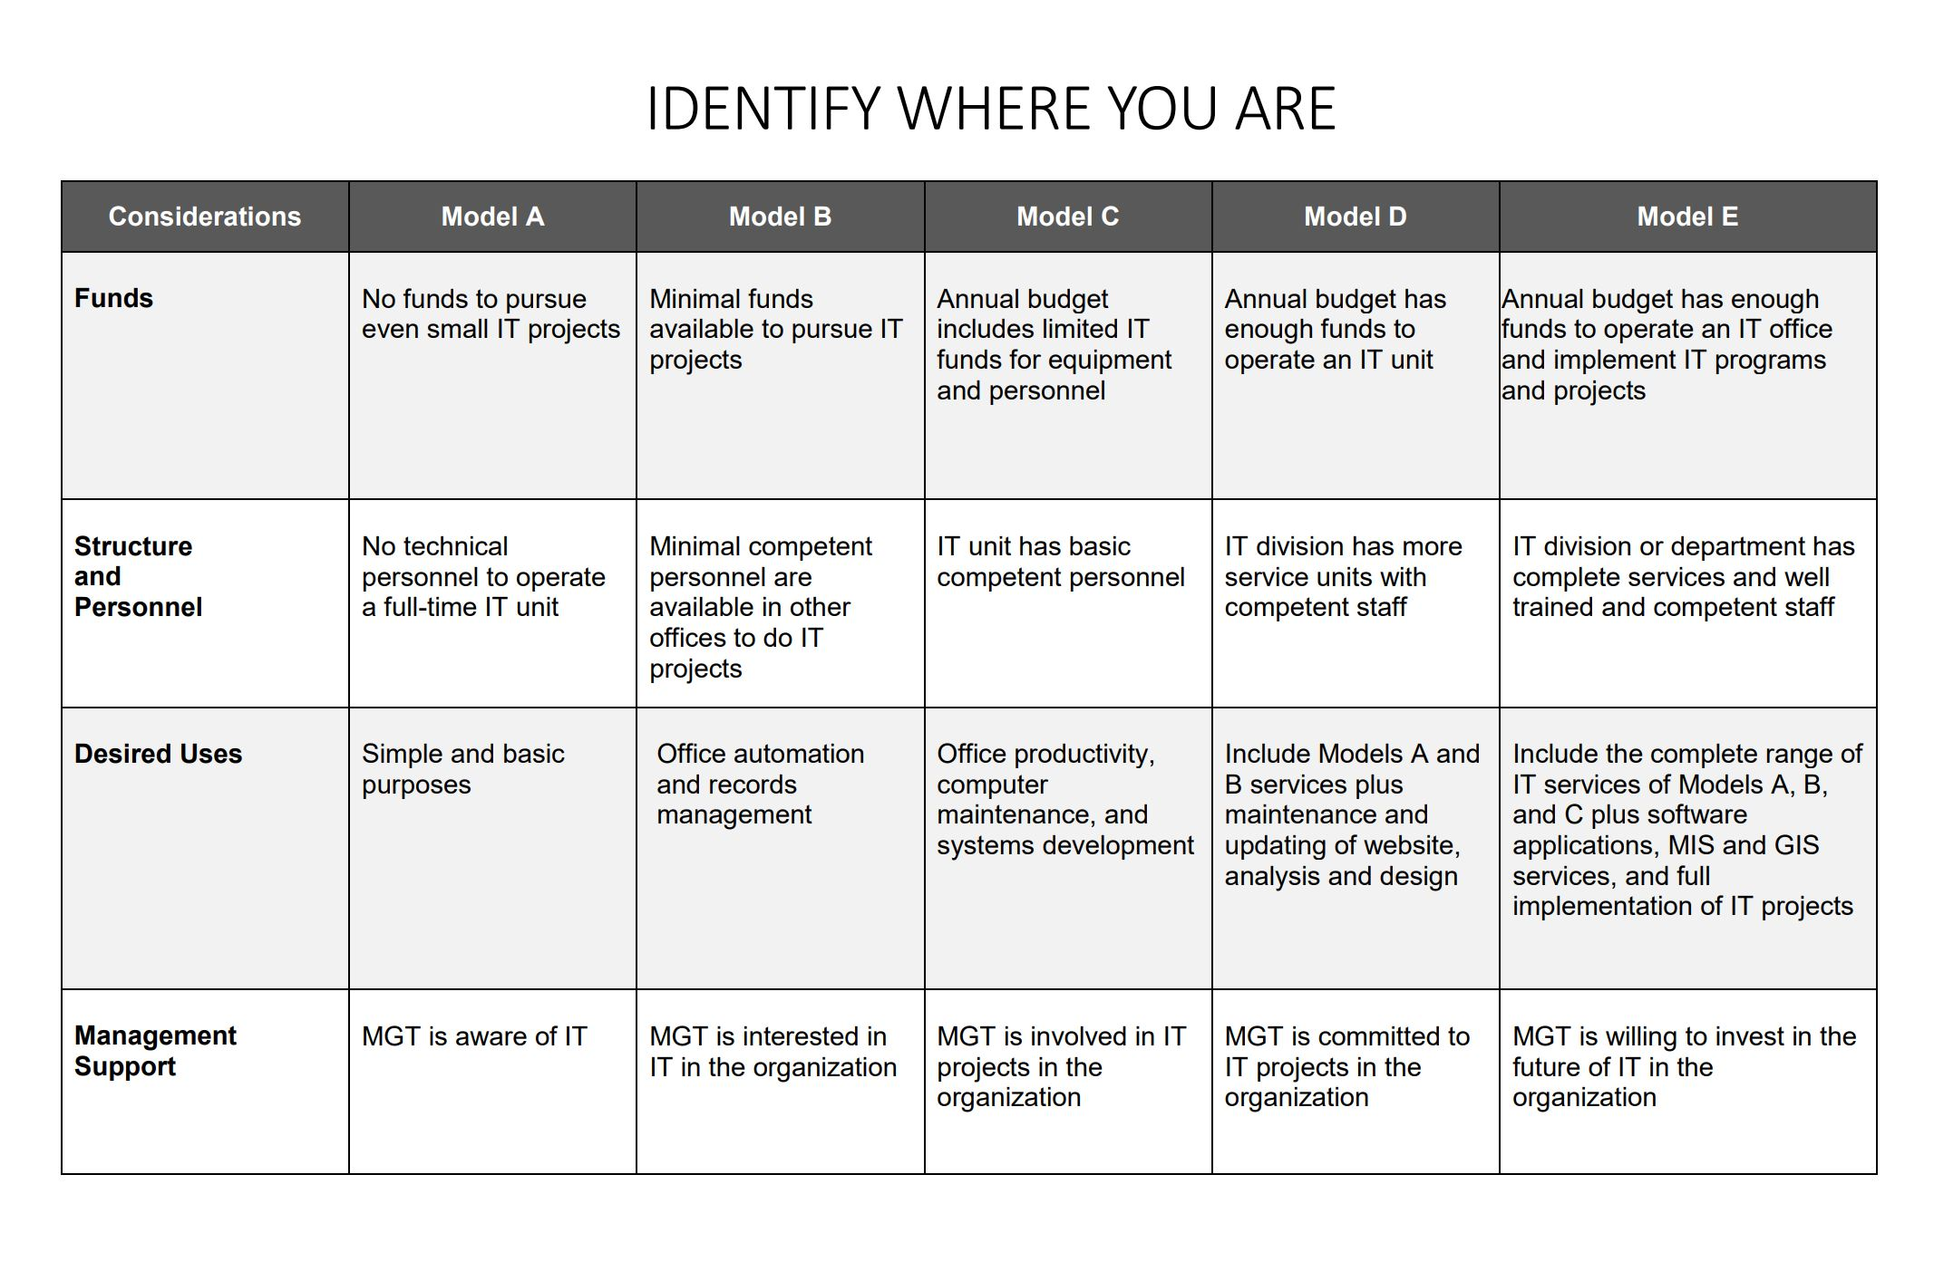

Slide 14
Swot analysis
How can we maximize the use of our strengths?
How can we overcome the threats identified?
What do we need to do to overcome the identified weaknesses?
How can we take advantage of our opportunities?

Slide 15
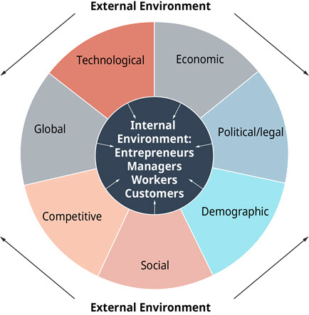
Step 4 Environmental Analysis
Organizations do not operate in a vacuum but rather in a dynamic environment that has a direct influence on how they operate and whether they will achieve their objectives.

Slide 16
What is the impact on the plan?
How do you want to communicate with your customers?
Should an application be provided?
A website?
Should we integrate social networks?
Do we have specific needs for the government?

Slide 17
Step 5 resources analysis
The first step to determine the current situation will be to establish an up-to-date list of your hardware and software assets.

Slide 18
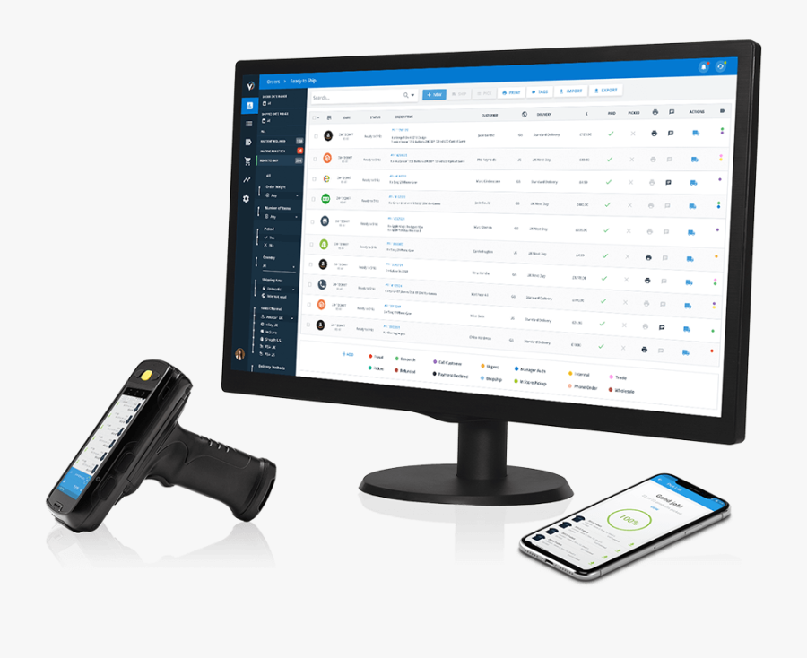
Hardware
Beyond five years, it is more difficult to have an efficient and compatible tool.
How many should we replace?
More needed?

Slide 19
software
List of systems, software
Purpose of each software
Suggestions from employees?

Slide 20
Human resources
What are the skills?
Training needs?
New implementation to come?

Slide 21
Step 6 Needs analysis
Time to consolidate the lists with each department
Meet the heads.

Slide 22
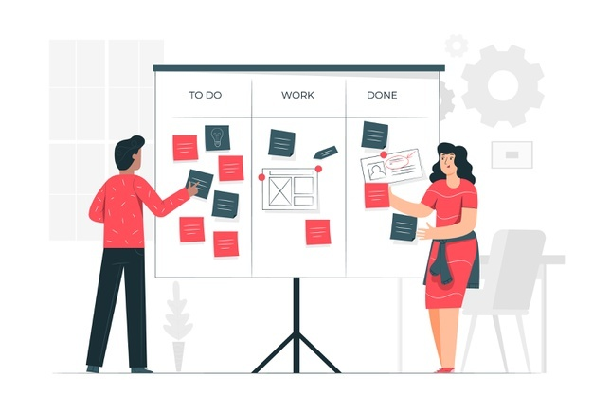
What is needed?
Verify the lists compiled with the employees
Do they think of a future implementation of softwares? of systems?
What are their objectives for future?
How can Information Technology help?

Slide 23
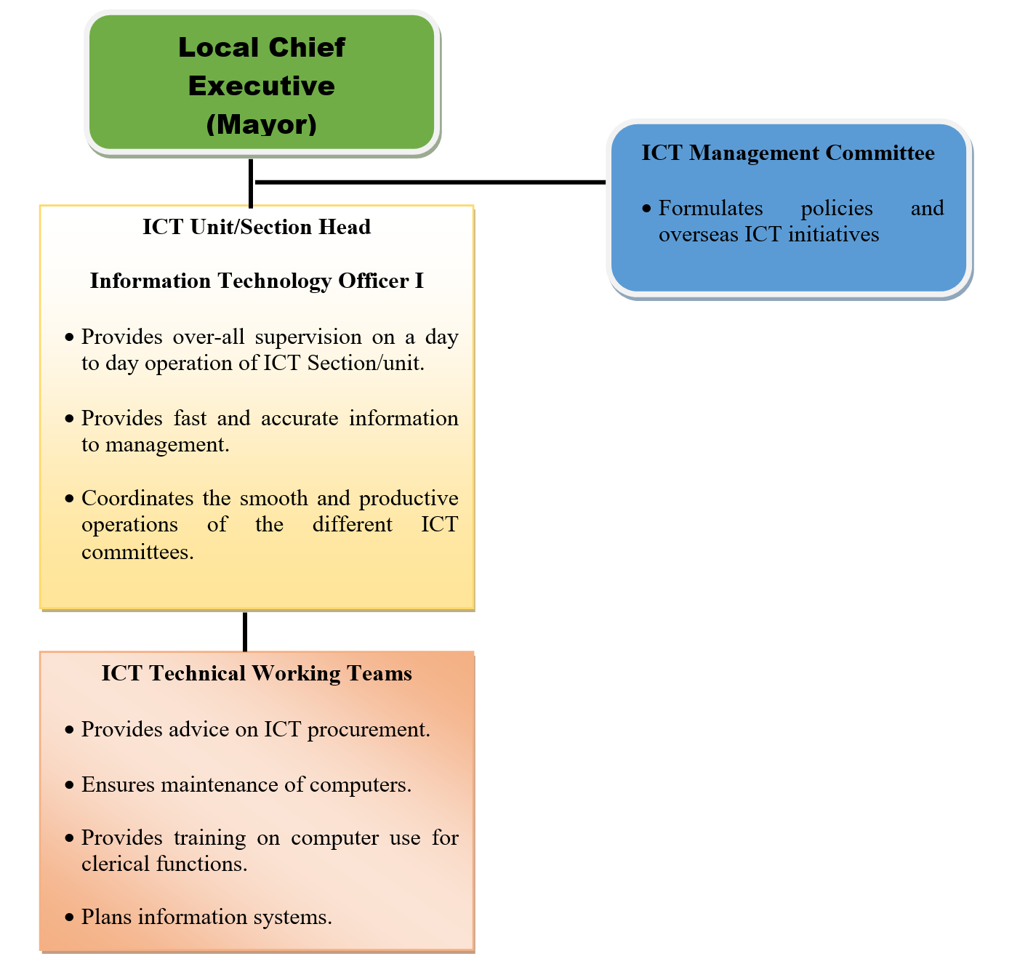
Creation of IT department?

Slide 24
Creation of IT Committee
Potential Members
Treasurer
Assessor
Budget
Social Welfare
Health
Agriculture
Accountant
MPDC
Administration
Engineer
Civil Registrar
Responsibilities
Monitor IT Projects
Take action to ensure projects completed on time and on budget
Evaluate new projects
Report on Status of IT projects

Slide 25
Step 7 Strategic choices
The organization must actualize a comprehensive IT strategy that is aligned to their business and corporate strategies.

Slide 26
Identify the priority
Give priorities to the needs
Should be related to the mission of the organization
Discussion and debate
What is the cost to your organization if you don’t have any strategic plan related to IT?

Slide 27
Step 8 implementation
How much this plan will costs? When should we implement?

Slide 28
costs
Update the costs because technology is changing very fast
Last approval before implementation

Slide 29
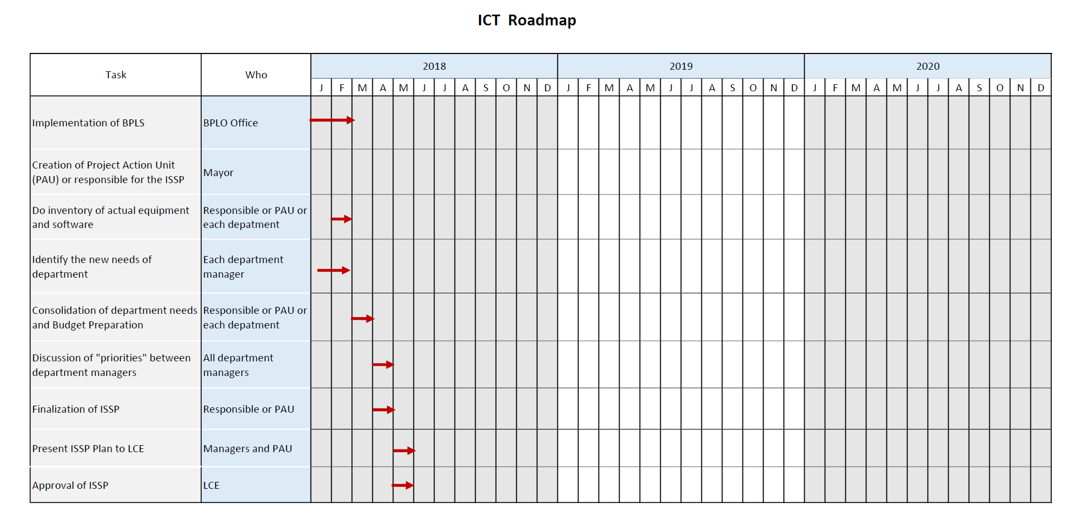
Roadmap
Create a detailed annual plan from multi-year implementation

Slide 30
Step 9 evaluation
The plan will be constantly evolving, as will the technology!

Slide 31
control
Set up appropriate qualitative and quantitative control measures
Possible causes can be identified and corrective actions can be taken.
Control acts as the central component in the plan and can therefore influence activities within previous and following phases.

Slide 32
ISSP … an ongoing process

